Slide 1
Final Presentation
Samuel Arseneault, Kelly Markaity, John Luu

Slide 2
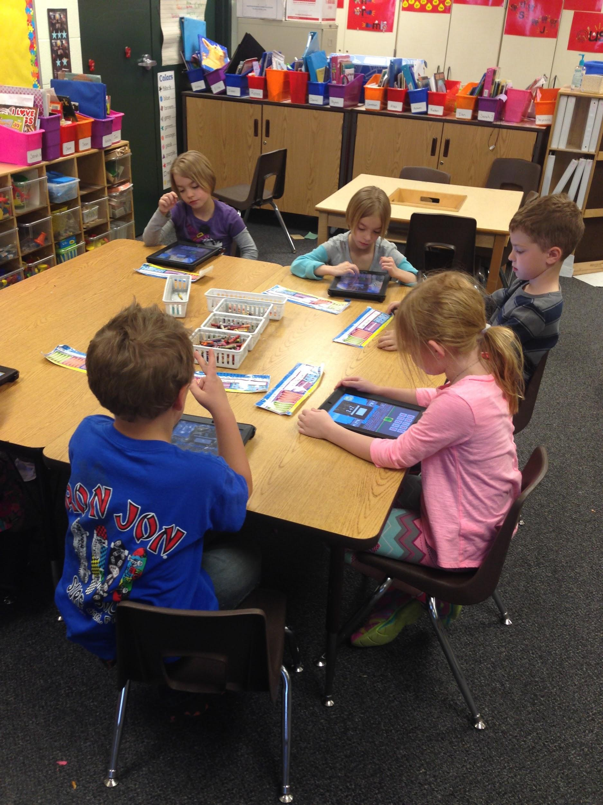
What is Grayling Math Racer?
Notes:
The rocket math project is the idea of having first grade students learn their math facts with an iPad. The students will interact with our Rocket Math app, and they will be asked to solve basic math problems. The difficulty of the basic math problems will be split into levels, which become increasingly harder as the students master each level. Once a level is mastered they will be able to move on to unlock new levels. While the students are solving these math problems, the statistics on their performance will be tracked. The data the students generate with this application would then be used to inform teachers how well their class is performing.The teachers will log onto an online portal, where they can view each individual student’s record. The Rocket Math project is essentially micro data mining first grade students to help track and improve their math skills.

Slide 3
Scope
Exercise first grade math skills
Track student’s data
Create an IOS application
Create a database
Create an online portal
Notes:
The rocket math project will include implementing an IOS application from scratch, implementing a database to store gathered information from the application, and creating an online portal to view the logged information.

Slide 4
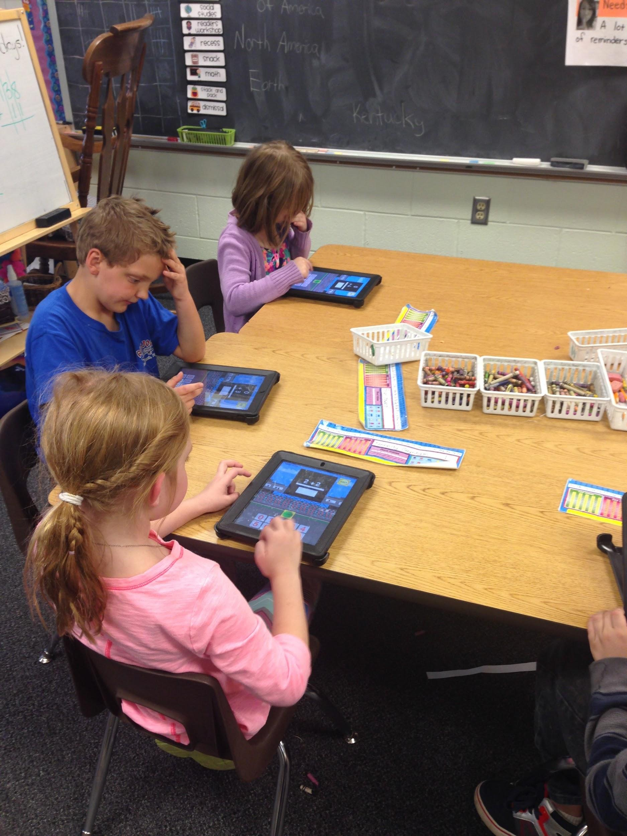
The IOS Application
Notes:
Again the IOS application will be where the students interact with the solvable math facts. This will include 0,1,2,… rules for addition, subtraction, multiplication, and division.

Slide 5

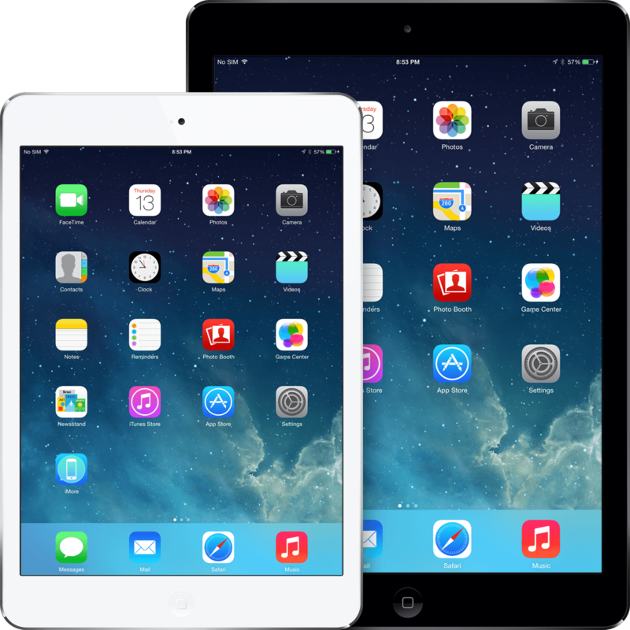
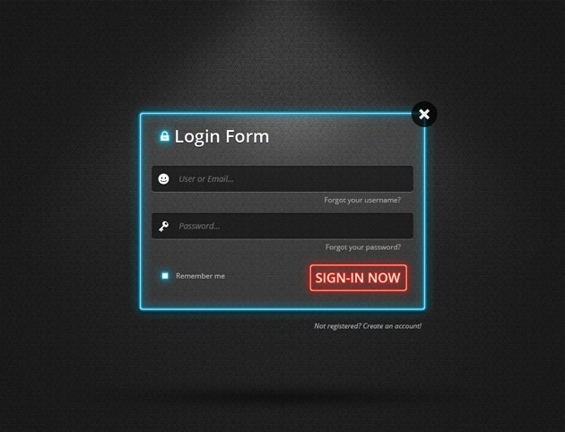
Behind the Scenes
Notes:
This is the basic idea of how it will work. Students will play our Rocket Math app on their iPads, and then their tracked data will be constantly streamed to a server. The type of data tracked will be number of questions right/wrong, time spent on question. Later on when a teacher is ready to review their students’ records, they will have an online login portal where they can access the data based. We also have plans to offer a settings menu in the online portal. The teacher would be able to modify the behavior of the app through the site, such as difficulty of math problems, or occurrence of math problems.

Slide 6
Early Stages
This is how our application looked in the beginning

Slide 8

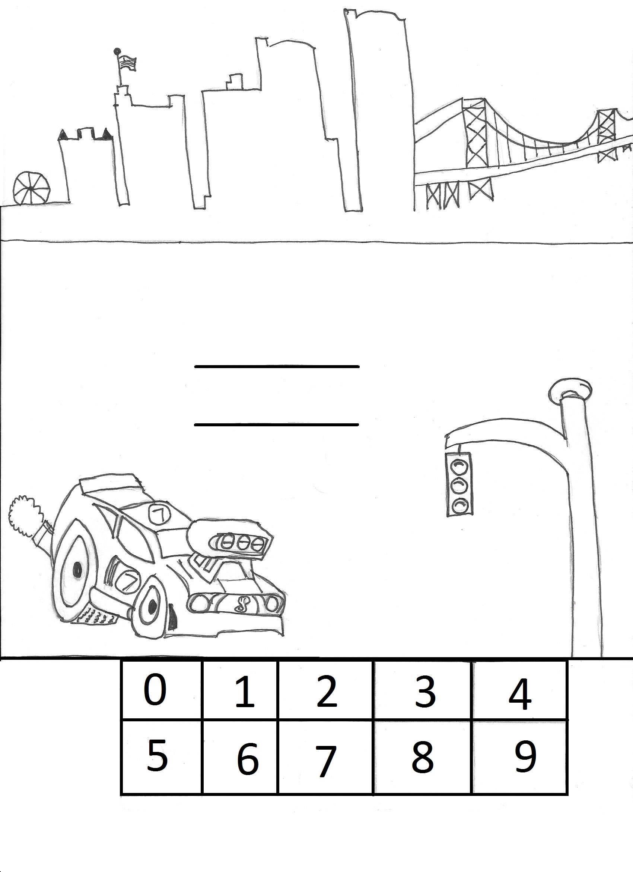
1st Prototype

Slide 9
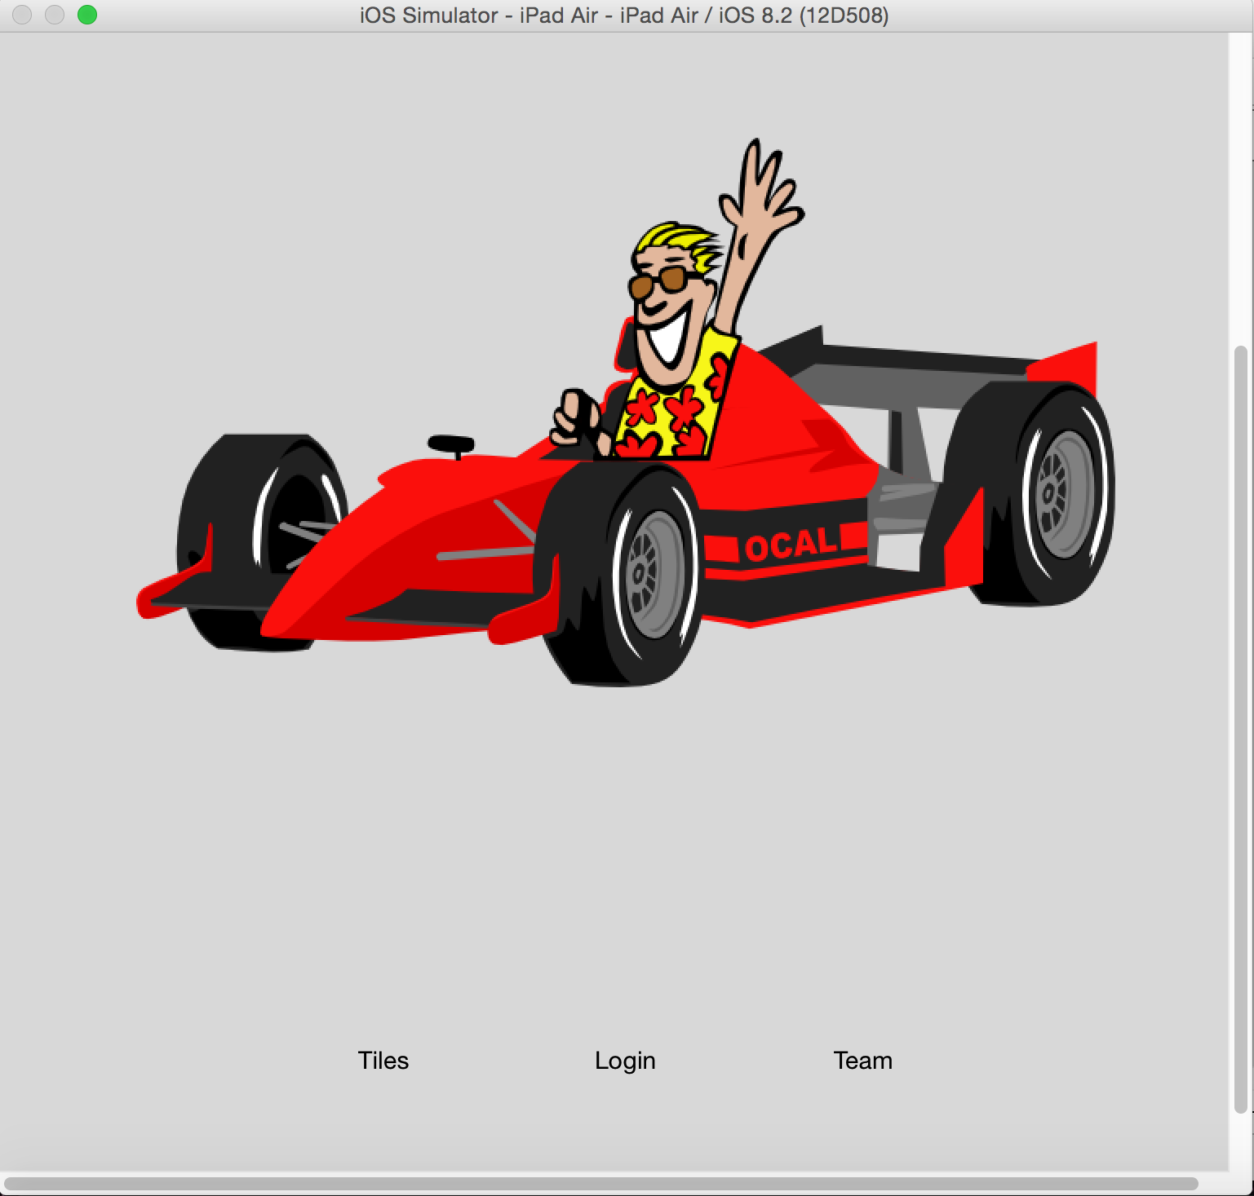
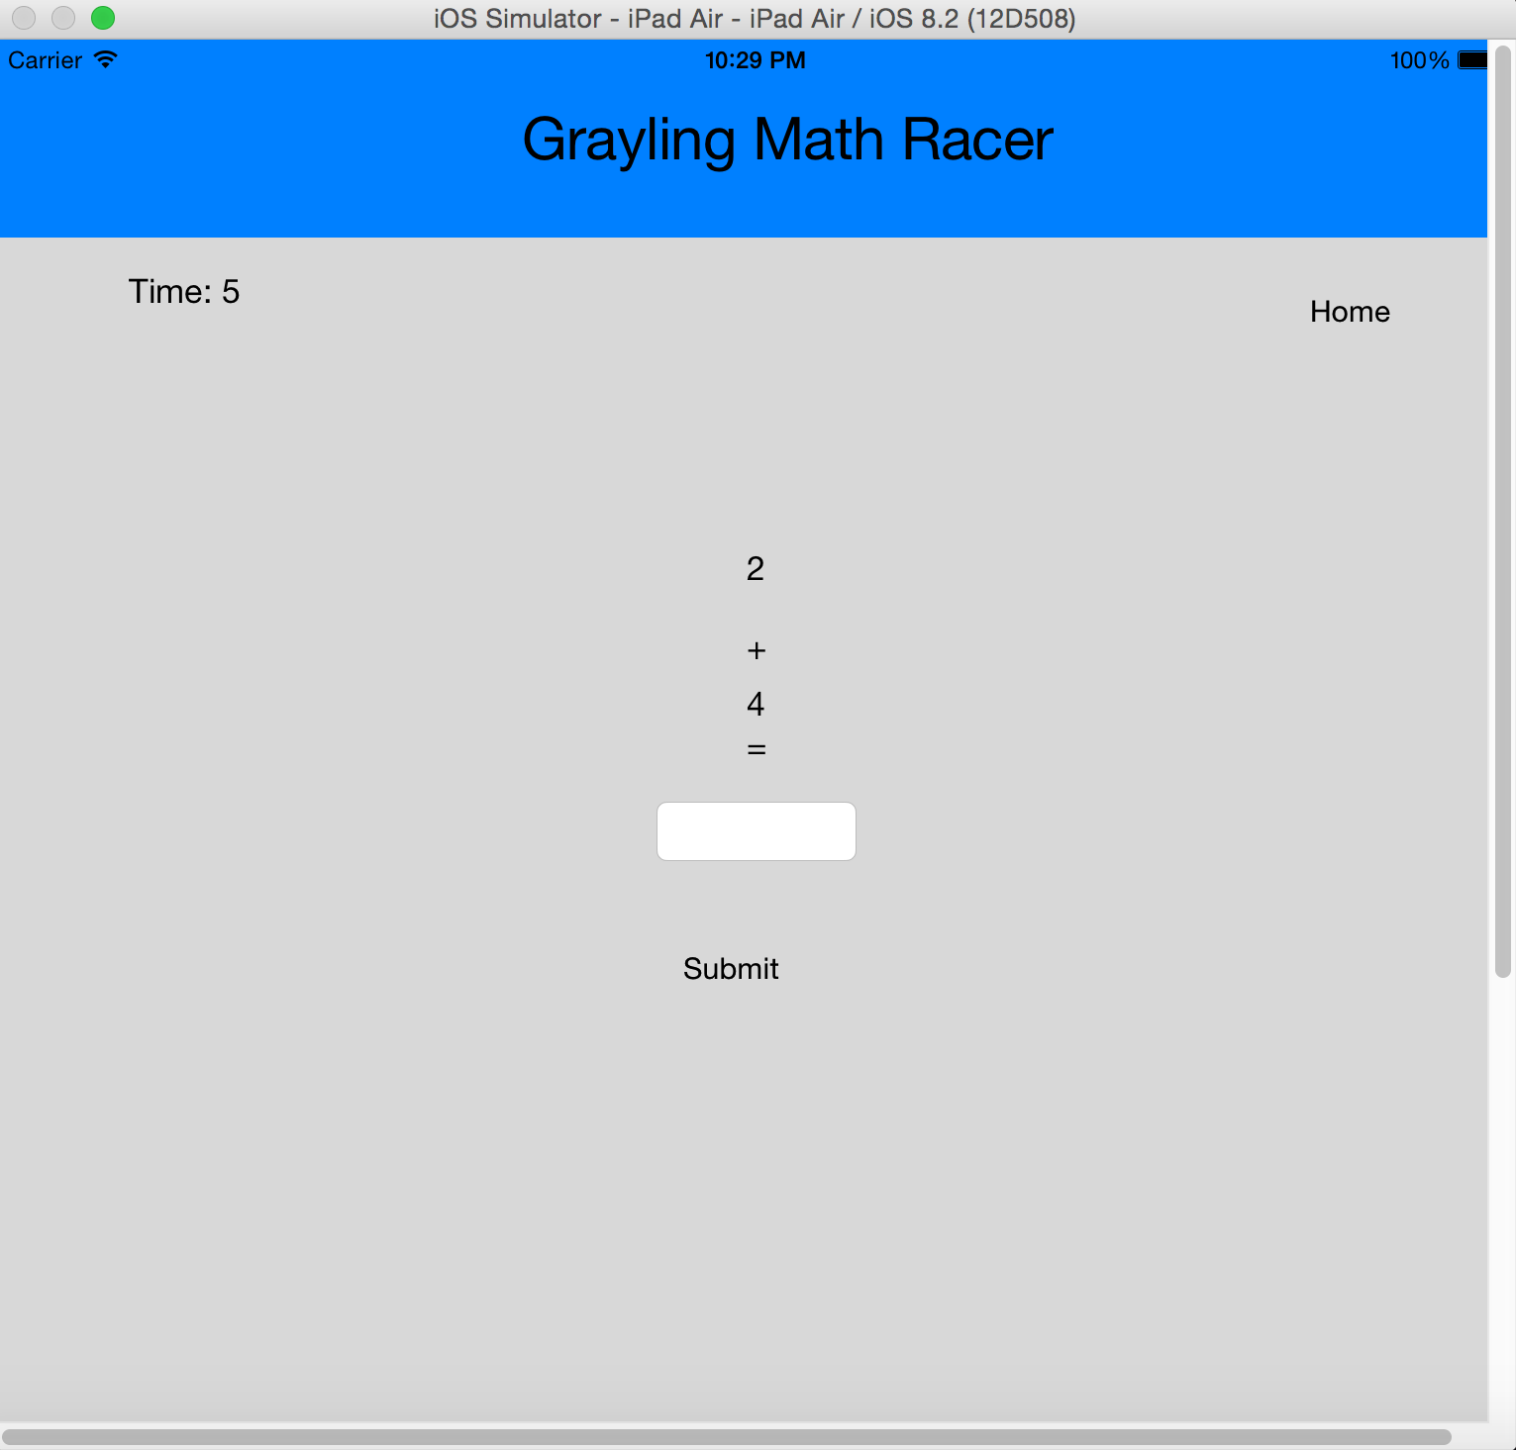
Second Prototype

Slide 10
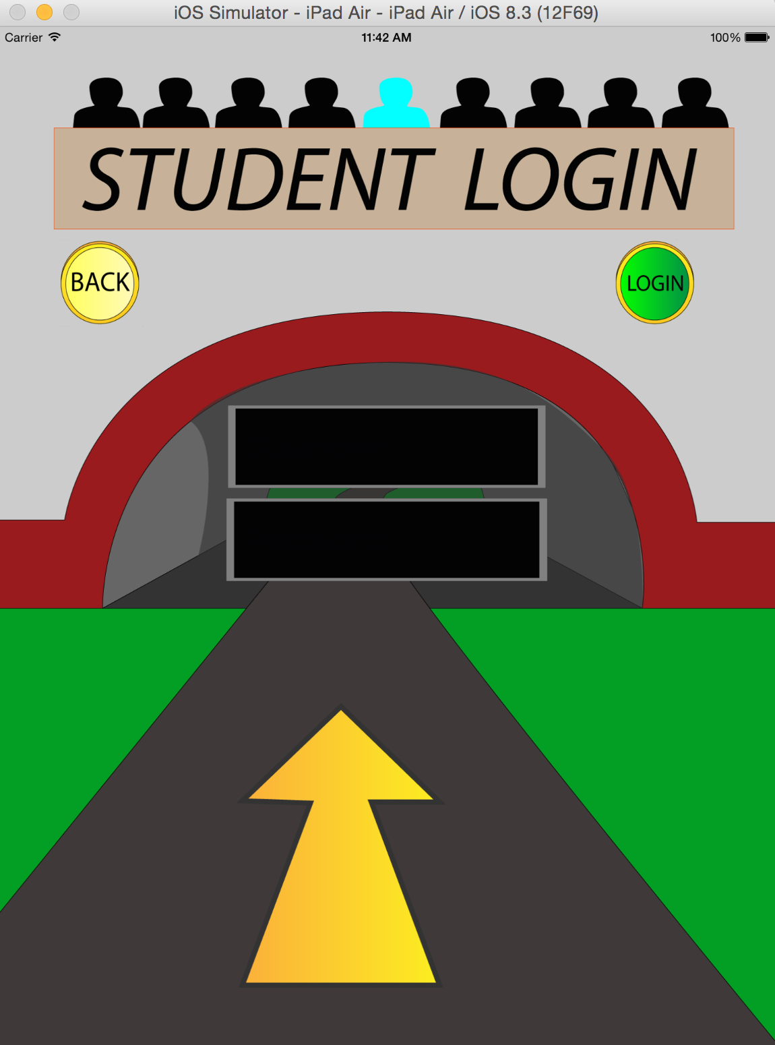
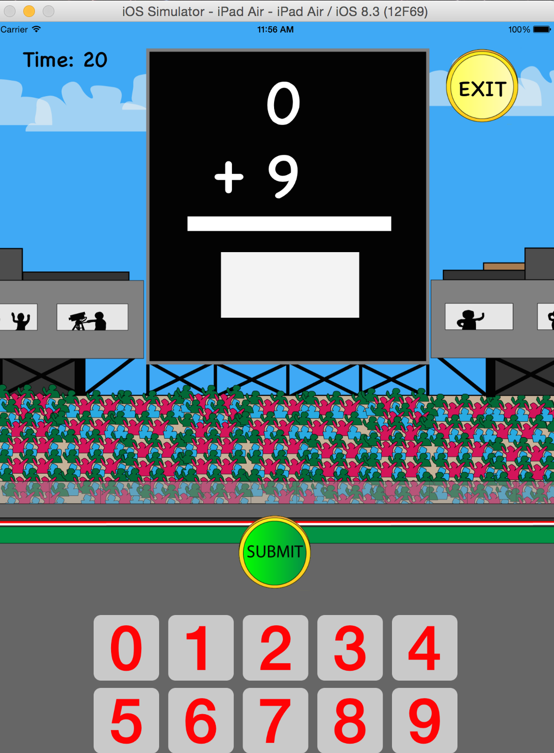
Final Product

Slide 11
Live Demo
Web Portal
iOS application

Slide 12
Grayling Elementary
Ms. Bouwhuis first grader responses

Slide 13
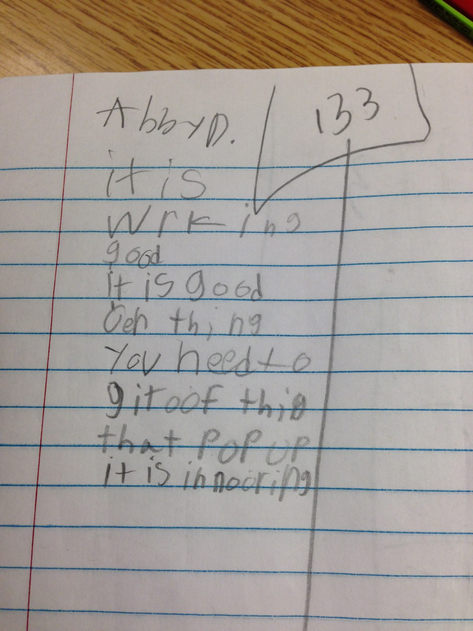
Messages
Message from Abby:
Translation?
It is working good,
It is a good and one thing you need to get rid of this that pop up is annoying

Slide 14
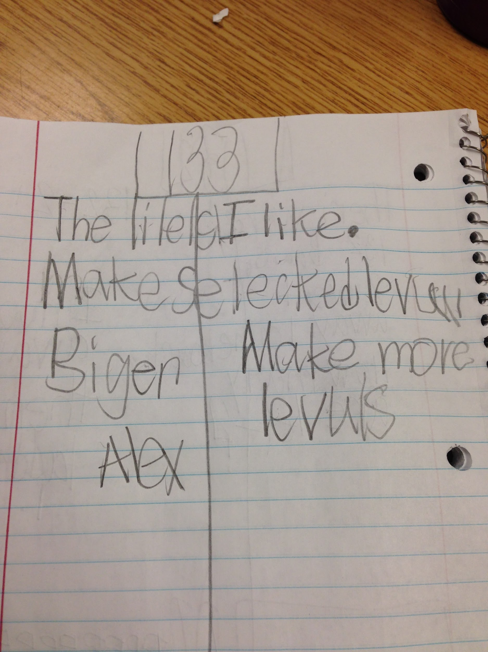
Messages
Message from Alex:
Translation?
The Tiles I like.
Make selected levels bigger
Make more levels

Slide 15
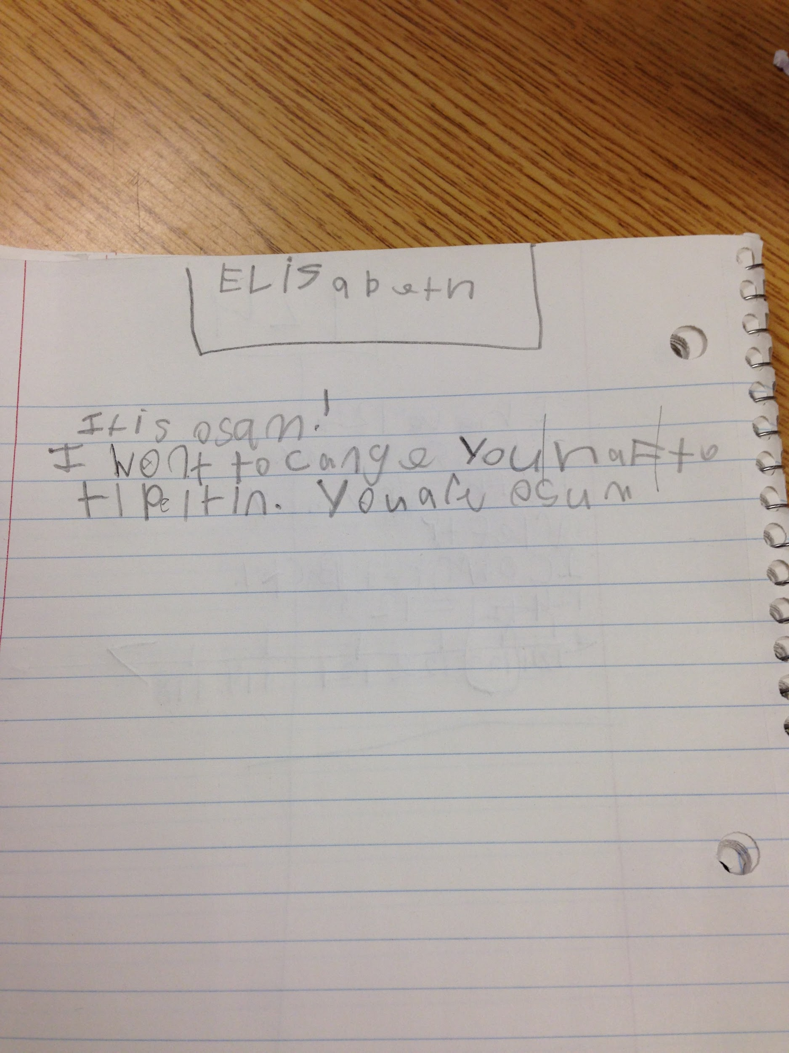
Messages
Message from Elisabeth:
Translation?
It is awesome!
I want to change it to type it in. You are awesome
Notes:
I assume she is referring to how answers are submitted. type in answers vs drag and drop tiles.

Slide 16
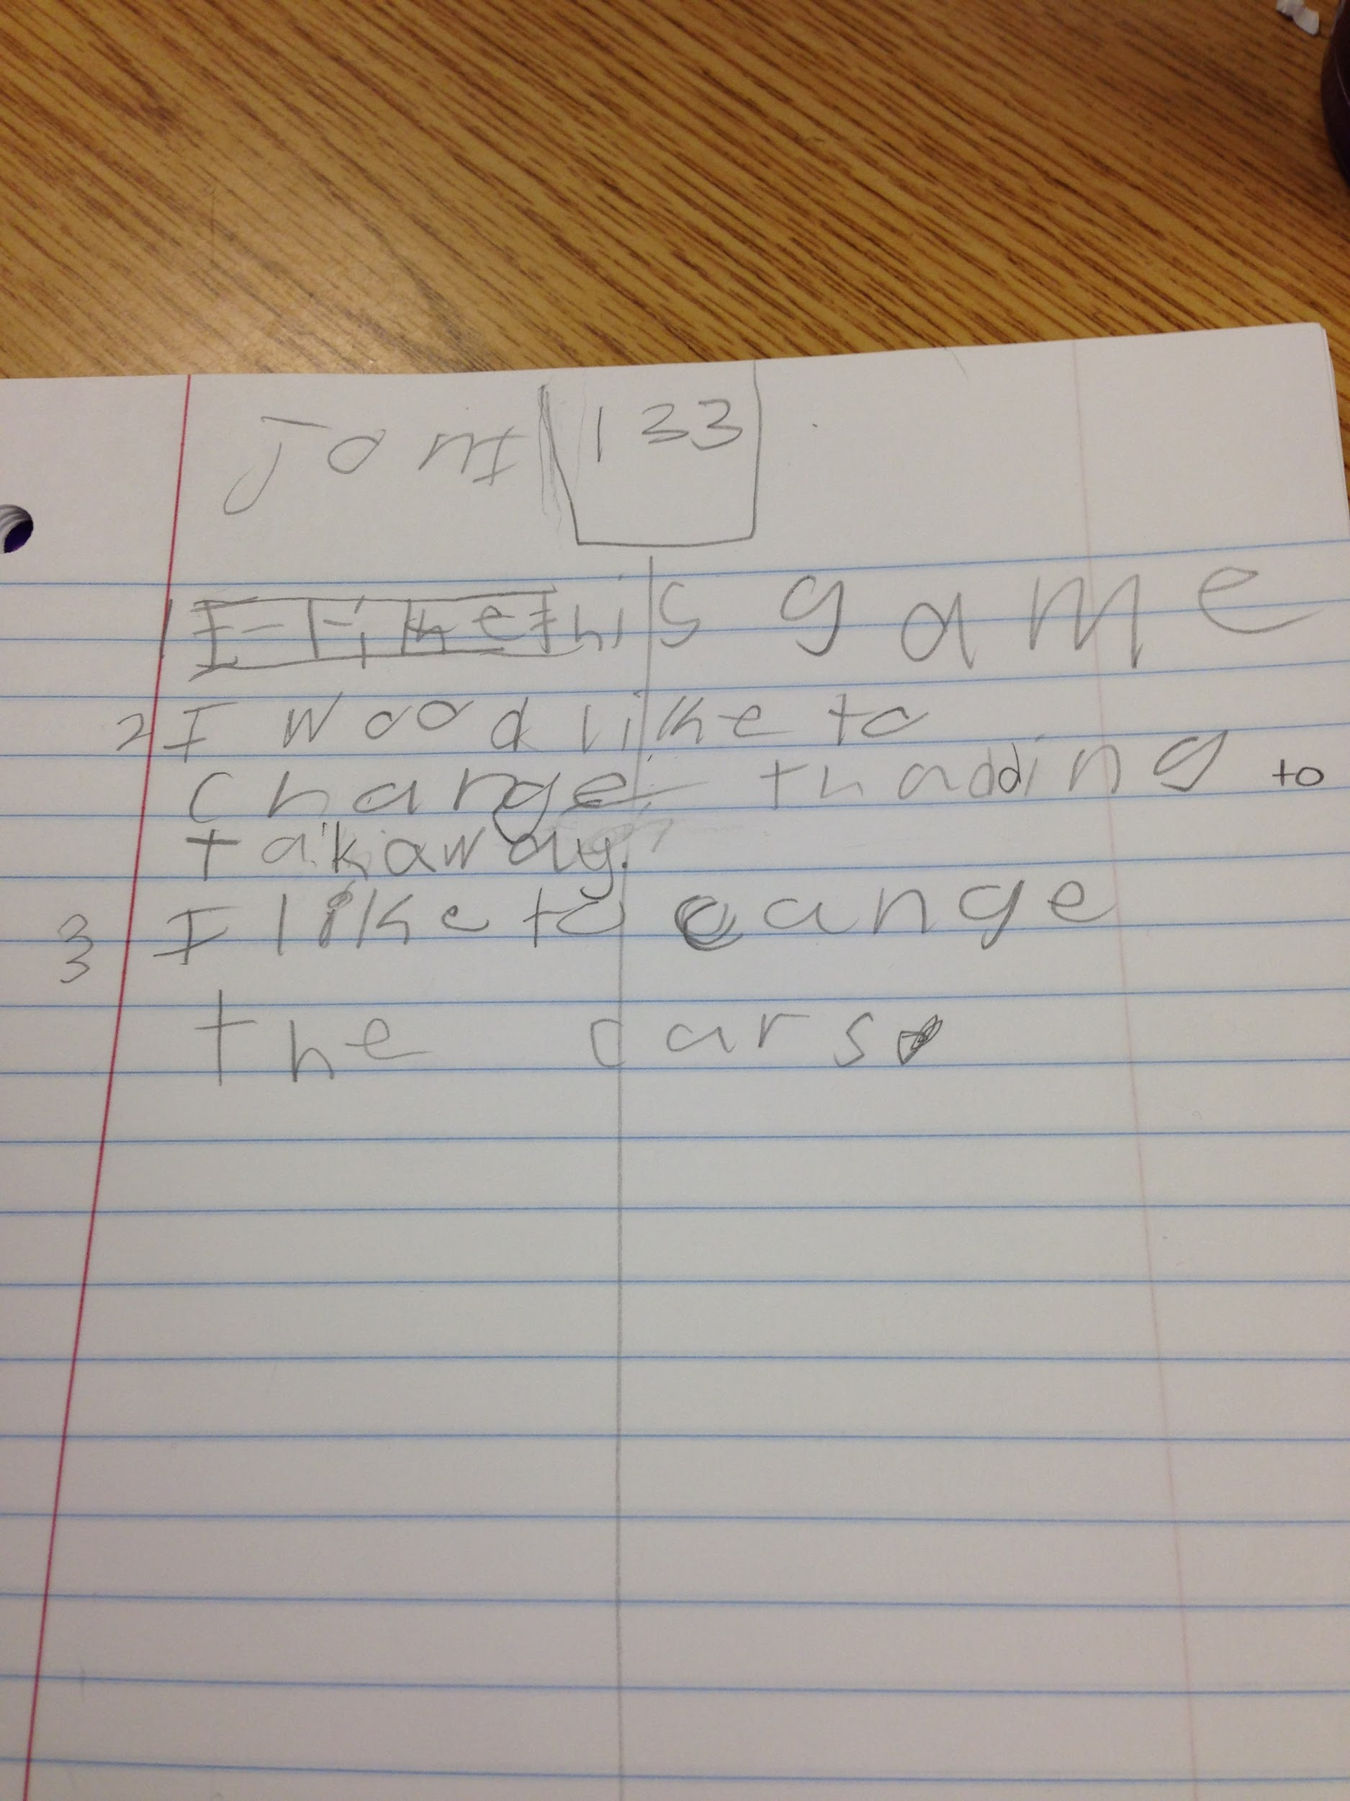
Messages
Message from Joni:
Translation?
I like this game
I would like to change the adding to takeaway
I like to change the cars
Notes:
#2, change addition to subtraction

Slide 17
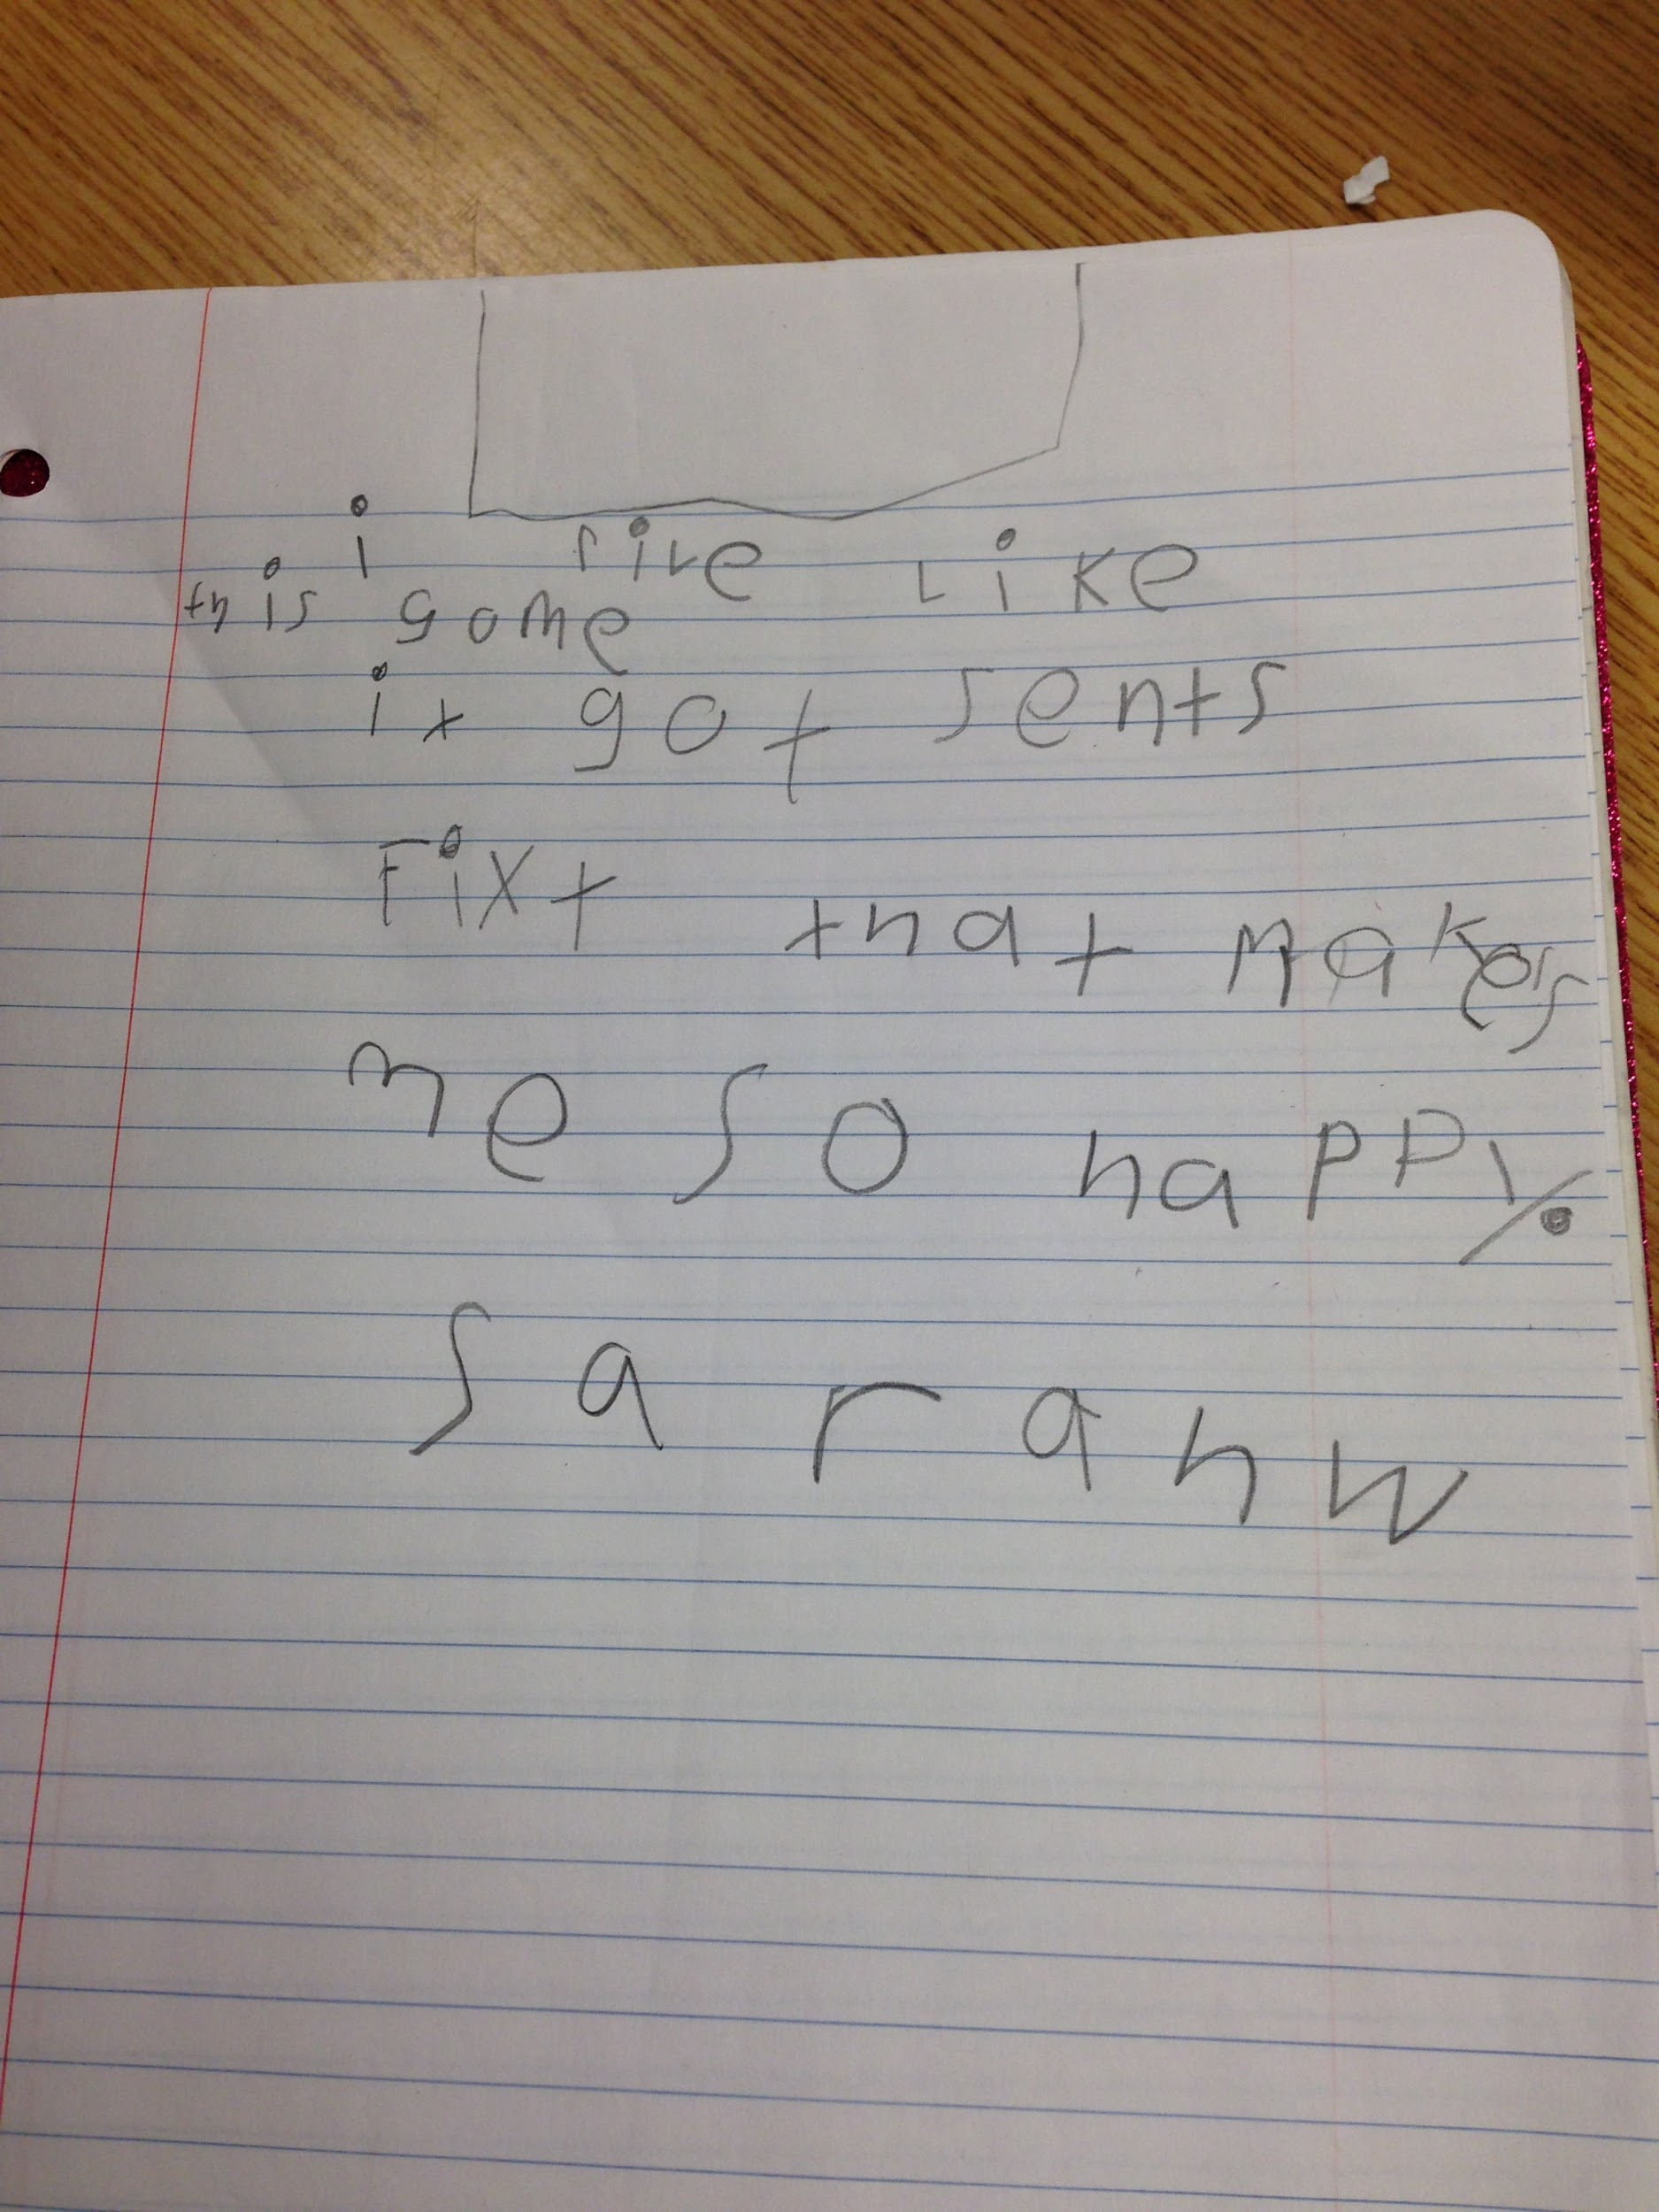
Messages
Message from Sarah W:
Translation?
This is awesome
I like it got since fixed that makes me so happy.

Slide 18

Messages
Kids say the darndest things!

Slide 19
